Slide 1
Detecting Fake News
Timeline to when fake news started and the correlation to Propaganda

Slide 2
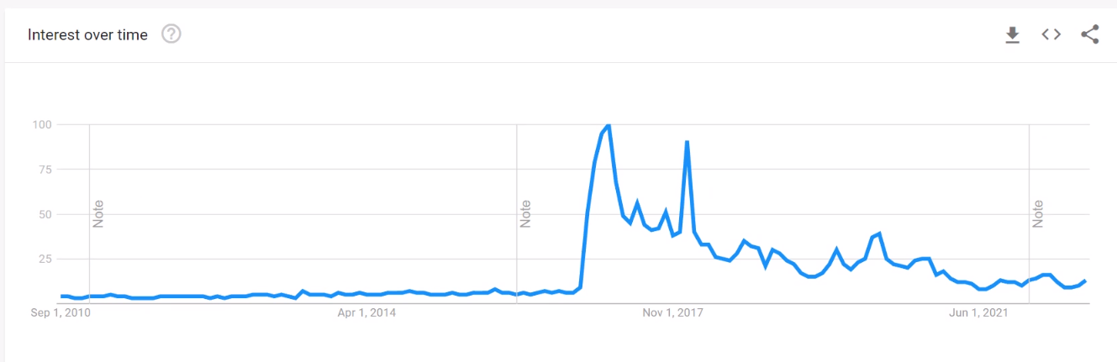
Google trends and Reporting fake news
Fake News is not a new Concept, however over the past century, we have seen the evolution of and availability of news progress at a tremendous pace. Google trends indicate this started around the 2016 Presidential election.

Slide 3
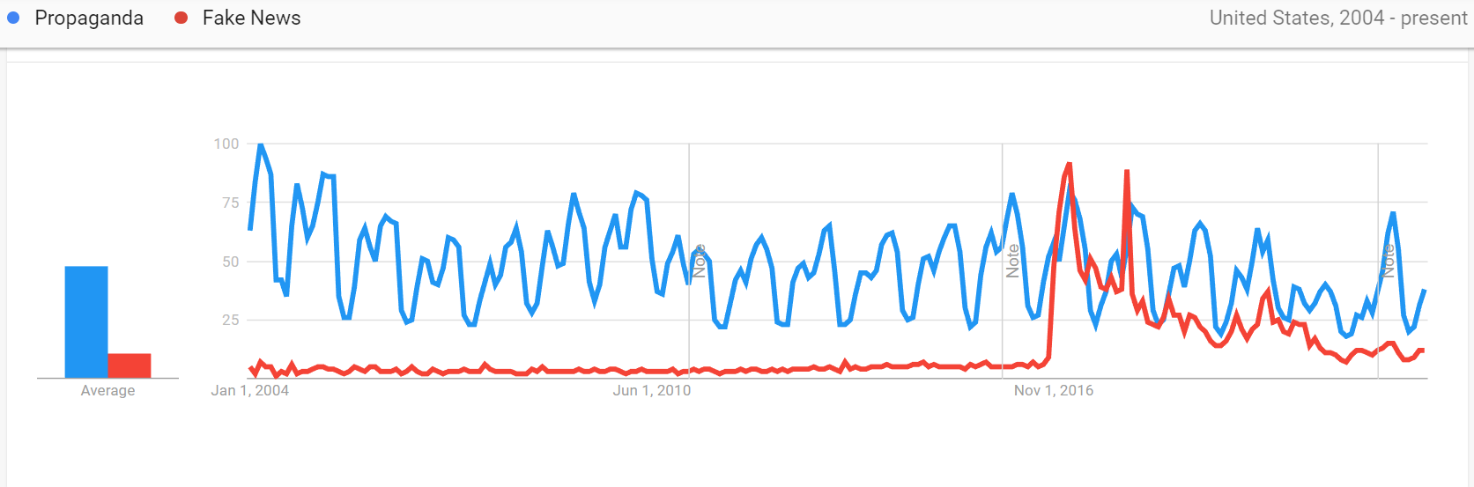
Propaganda and fake news
In relation, we determined to expand deeper into the events surrounding fake news. It is difficult to believe that this topic suddenly became relevant after 2016. Therefore, we provided a google search for “Propaganda”. Propaganda is information of bias or misleading information to promote political point of view. Coupling google searches for fake news in correlation with propaganda, we can visually witness a similar trend between the two.

Slide 4
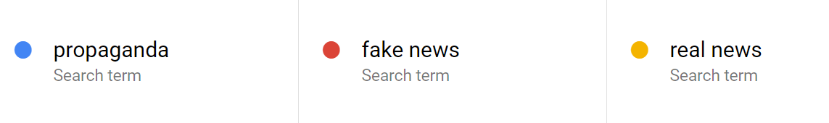
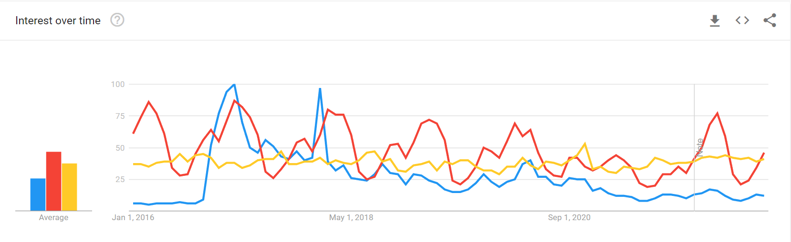
Correlation between fake news, propaganda, and real news

Slide 5
Assumptions about fake news
“There’s an assumption that fake news exacerbates polarization. But it might be the case that polarization exacerbates fake news.”
People often say that “social media” platforms can spread fake news more quickly than ever before. However, prior to any social media platforms had taken off, there was news that was spreading that was fake (Iraq might have weapons of mass destruction). We often assume that social media spreads more rapidly because people are more in tune with these platforms. But the fact of the matter is people in the same country, same family, or community can have different takes on reality.
Truth- what is the motivational reasoning behind the beliefs or opinions? If you are motivated to believe negative things on Hilary Clinton, you are more than likely to trust outrageous stories on her that may not be true.
The second concept on truth is “naïve realism” our tendency to believe that our perception of reality is the only accurate view. Naïve realism helps explain the political confusion in the country and maybe is the reason on why people spread fake news.

Slide 6
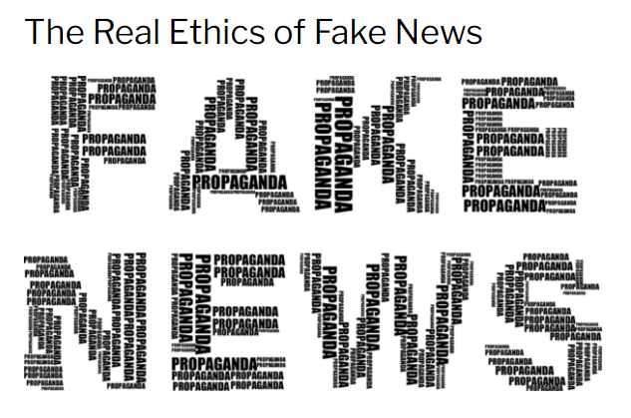
The real Ethics behind Fake news
Dr. Scott R. Stroud University of Texas – Austin uses the theory of pragmatism to explain how unethical it is to report fake news. John Dewey developed a pragmatic theory of inquiry to provide intelligent methods for social progress. He believed that the logic and attitude of successful scientific inquiries, properly conceived, could be fruitfully applied to morals and politics.

Slide 7

Conclusion: Using Data Science to help flag fake news
Data science will try to find patterns in data that will differentiate between Fake news and real news. Coupled with algorithms and large sets of data, data science can give the necessary insight to help find patterns within the data that would otherwise take a long time to discover to never be discovered at all. Artificial Intelligence or machine learning may be used to detect patterns that may characterize fake news when the human eye cannot see it clearly. There have been many studies show that since the 2016 elections the rise of fake news has risen.

Slide 8
Sources:
https://trends.google.com/
www.Pewresearch.org
https://insight.kellogg.northwestern.edu/article/the-psychology-behind-fake-news
https://www.buzzfeed.com/craigsilverman/fever-swamp-election
www.Homelandsecuritynewwires.com
https://mediaengagement.org/research/the-real-ethics-of-fighting-fake-news/
Dr. Scott R Stroud – Professor at the University of Austin Texas- Youtube

